Slide 1
Exercise 3A 1.
Ch3 representing data
P 32

Slide 2
Ch3 representing data
1. Find Frequency density using: $Frequency density= \frac{Frequency}{Class width}$

Slide 3
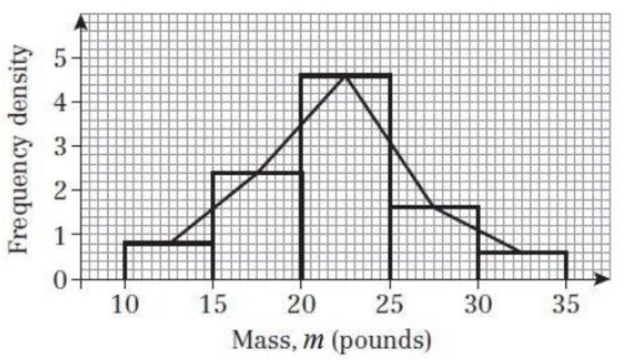
Ch3 representing data
1. Find Frequency density using: $Frequency density= \frac{Frequency}{Class width}$
F.D. = 0.8, 2.4, 4.6, 1.6, 0.6
This will be the height of the bar

Slide 4
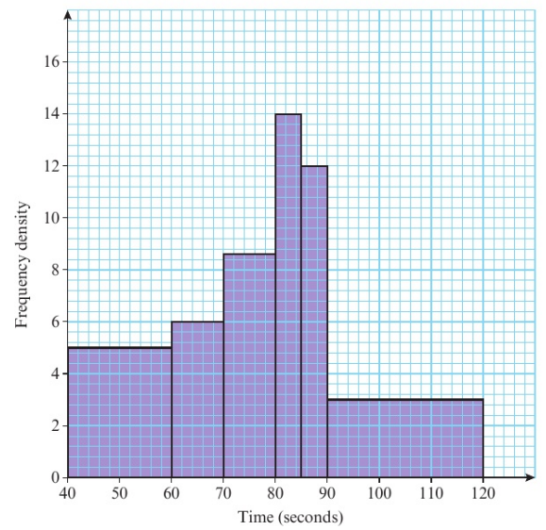
Ch3 representing data
2. a. because it is continuous data
B. Find the number of students per square, find the area of 40- 60
C. Adding the total squares = 246 x 1.5
D. calculate the total area under the curve

Slide 5
Ch3 representing data

Slide 6
Ch3 representing data

